Slide 1
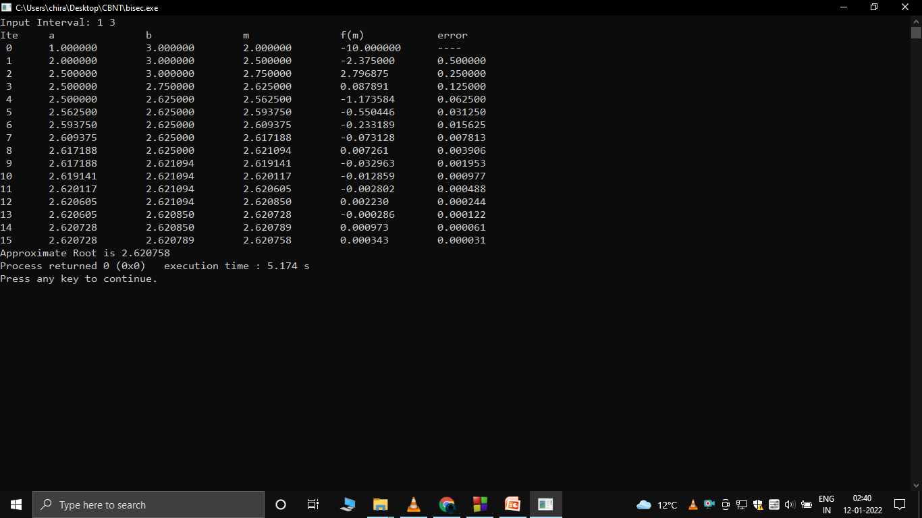
Bisection Method – Chiranjeev Kashyap

Slide 2
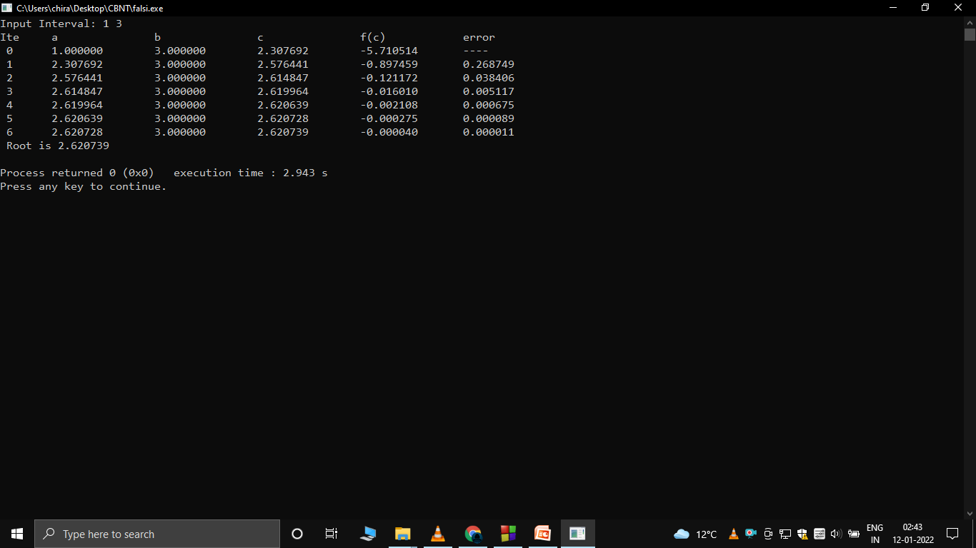
Regula Falsi Method – Chiranjeev Kashyap

Slide 3
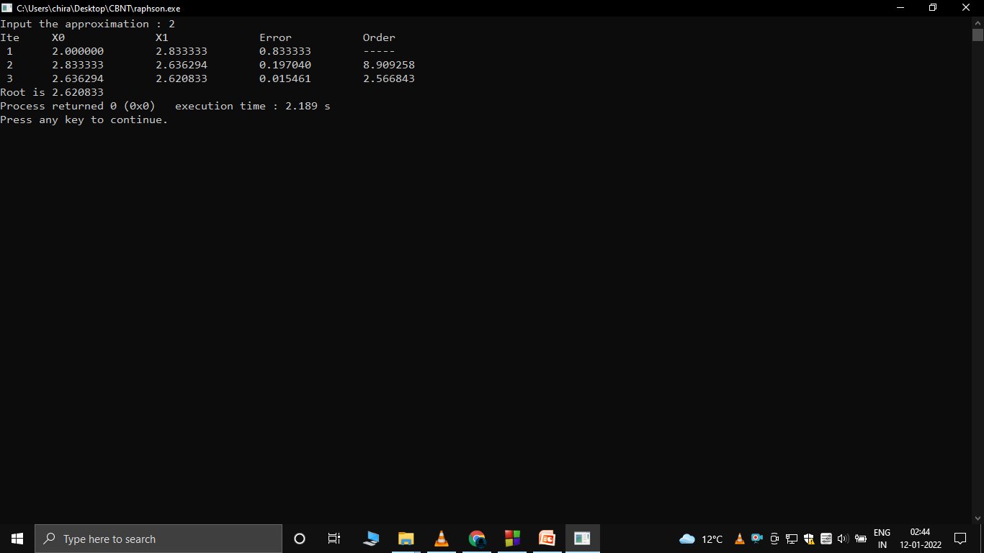
Newton Raphson Method – Chiranjeev Kashyap

Slide 4
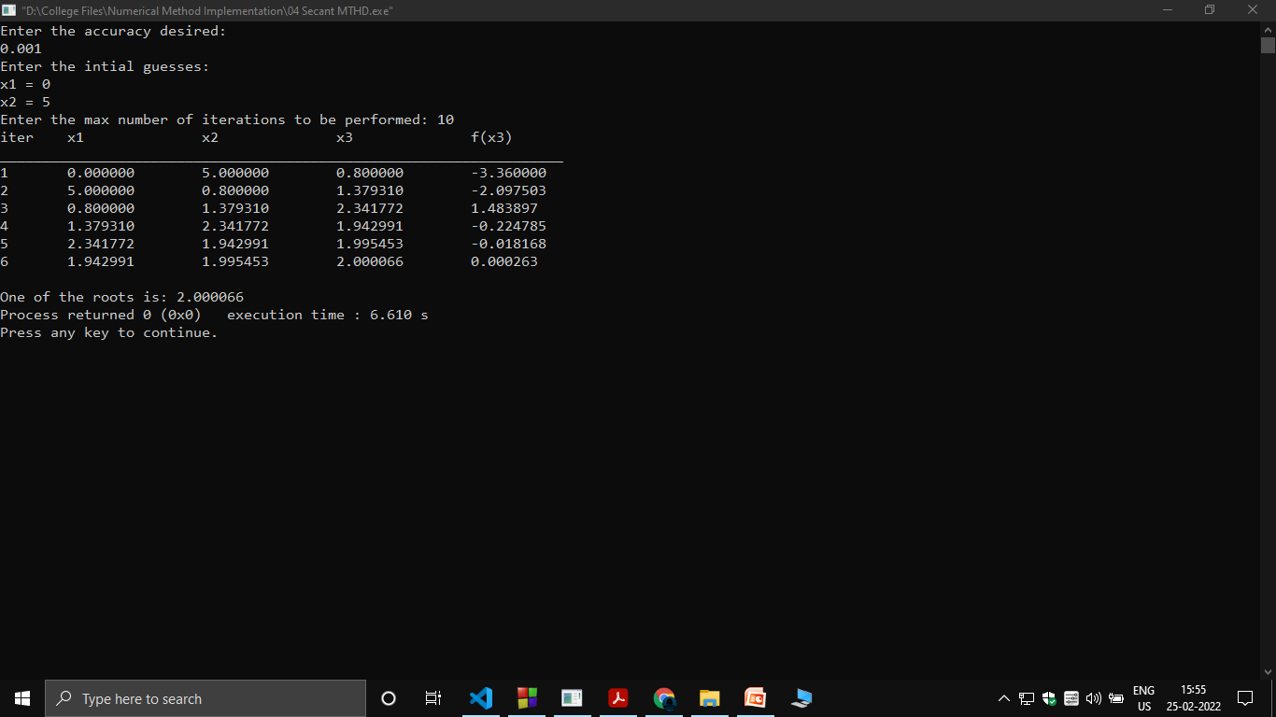
Secant Method – Chiranjeev Kashyap

Slide 5
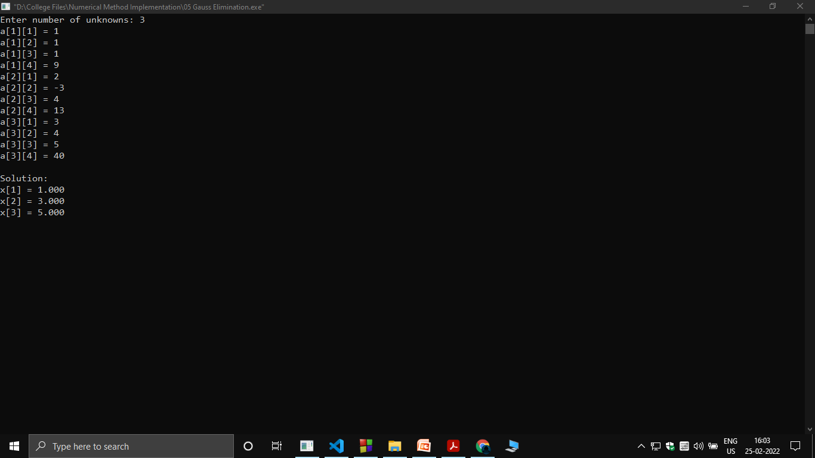
Gauss Elimination Method – Chiranjeev Kashyap

Slide 6
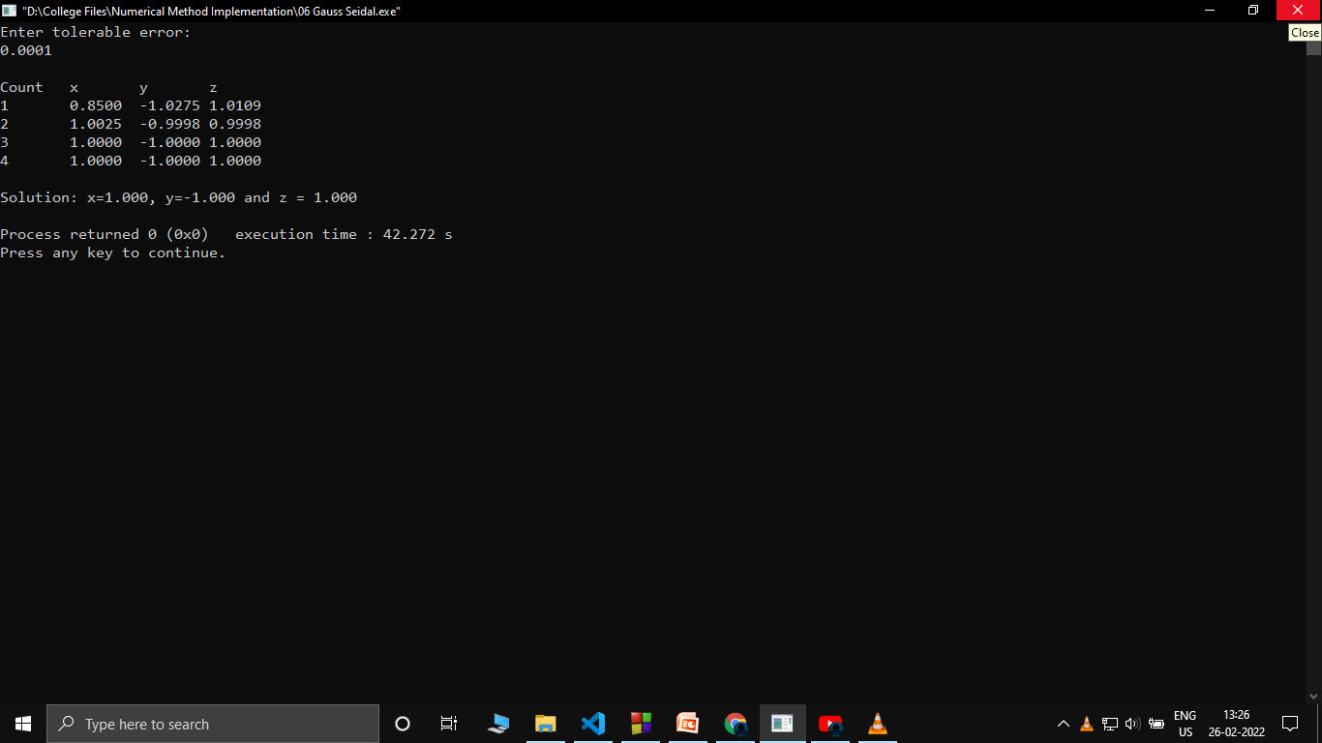
Gauss Seidal Method – Chiranjeev Kashyap

Slide 7
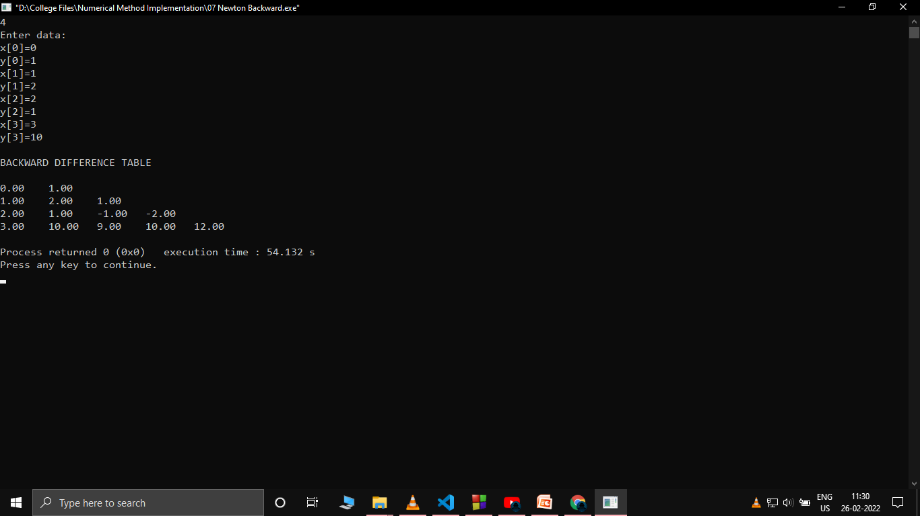
Newton Backward Method – Chiranjeev Kashyap

Slide 8
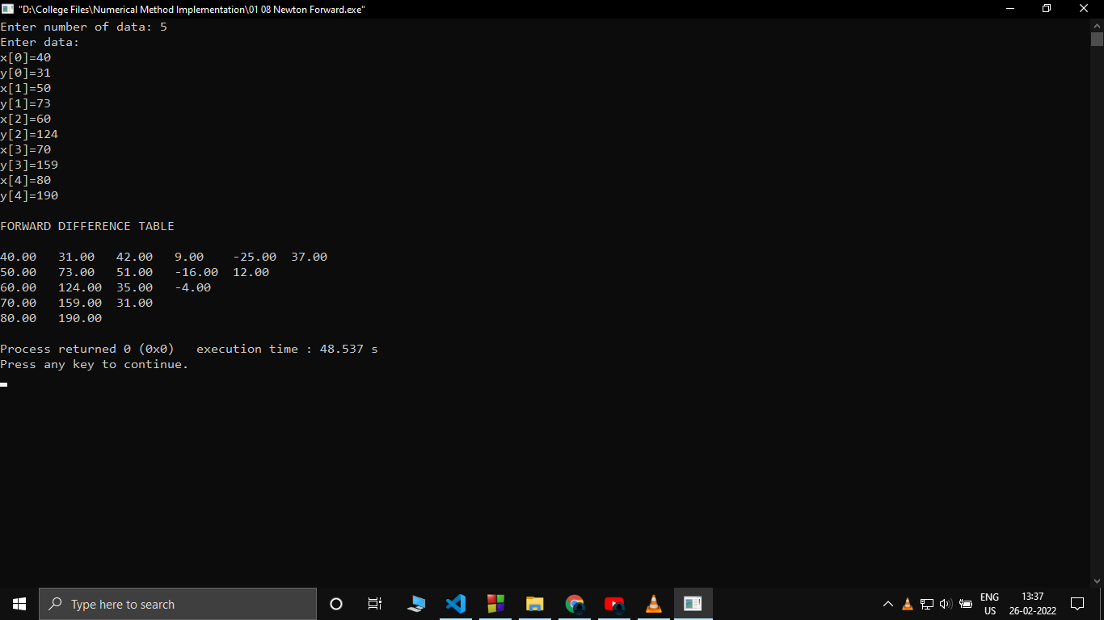
Newton Forward Method – Chiranjeev Kashyap

Slide 9
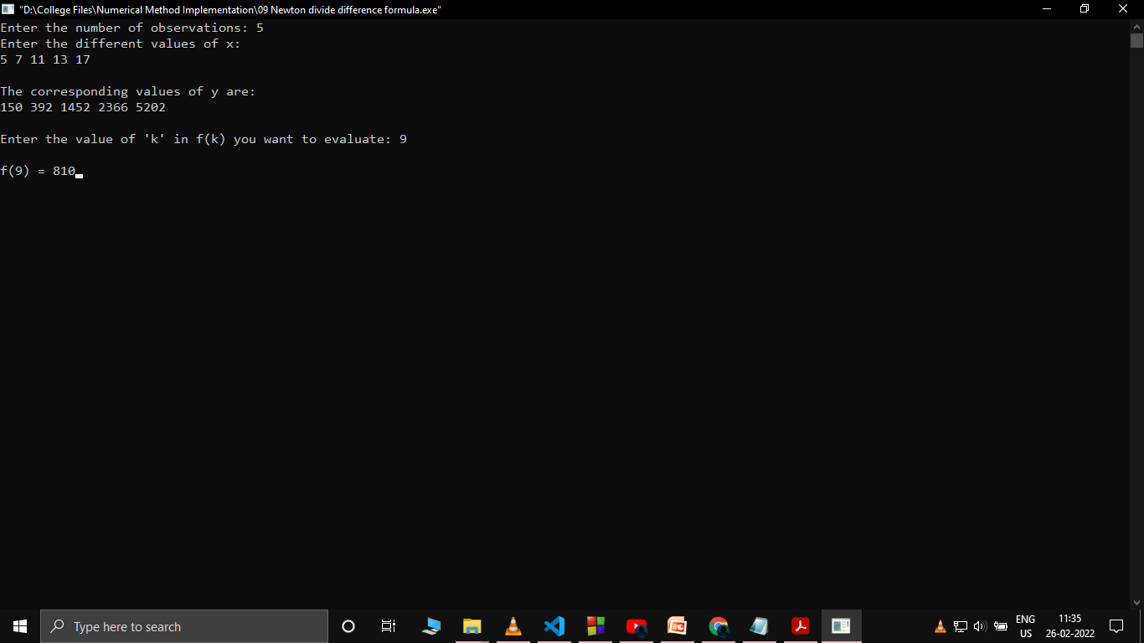
Newton divide difference formula Method – Chiranjeev Kashyap

Slide 10
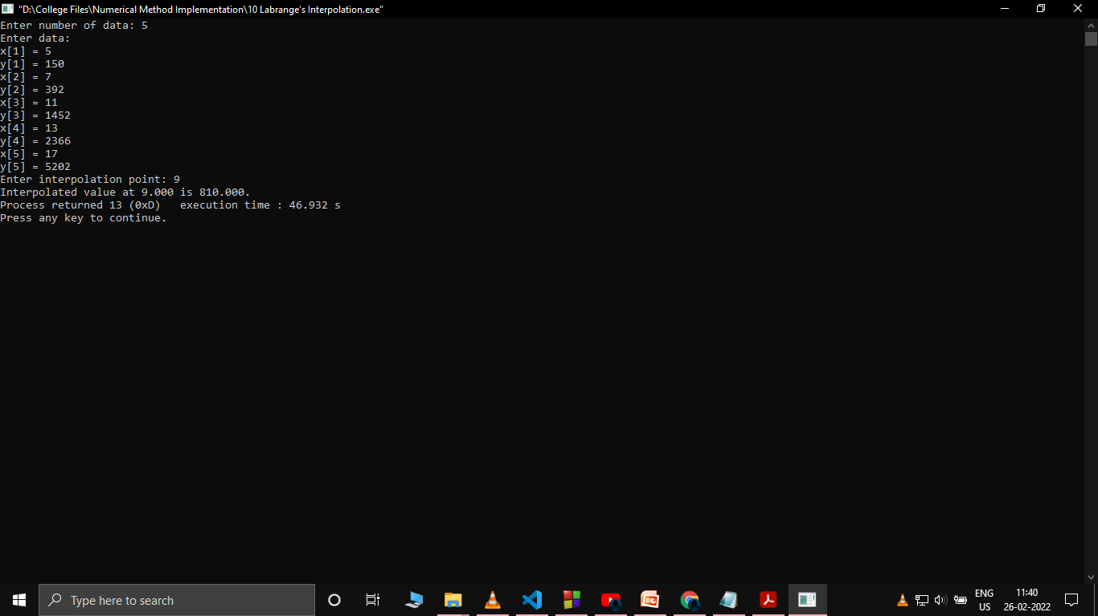
LaGrange's Interpolation Method – Chiranjeev Kashyap

